Slide 1
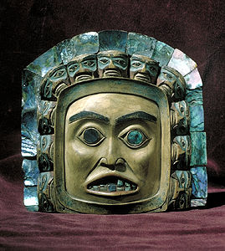
First Nations Government
Follow along on your worksheets and fill out as we go!
Remember: this topic is all about respect!

Slide 2
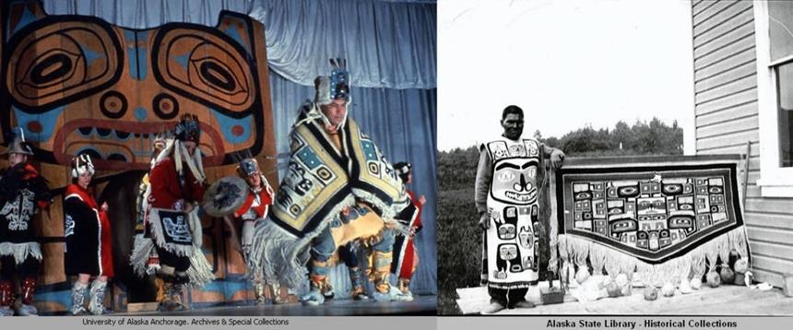
1. Who are the first nations peoples of Canada?
All of these terms include First Nations Peoples:
Aboriginal
Indigenous
First Peoples
Canada has First Nations, Inuit, and Metis peoples. Each group has their own unique languages and cultural practices. How cool!

Slide 3
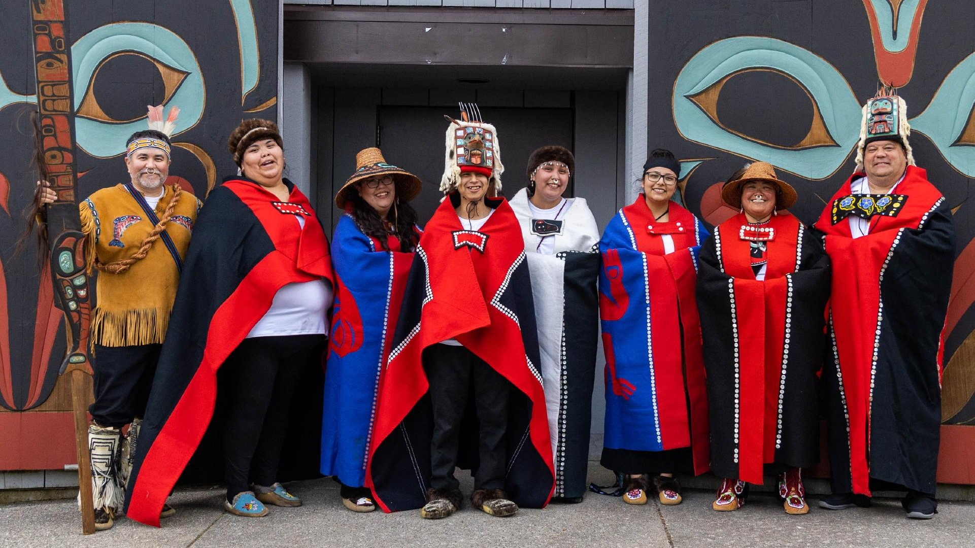
Family and community
In Indigenous communities, Elders are often the teachers.
Discussion: Is there a family member that you have who taught you a skill? What skills have they taught you?

Slide 4
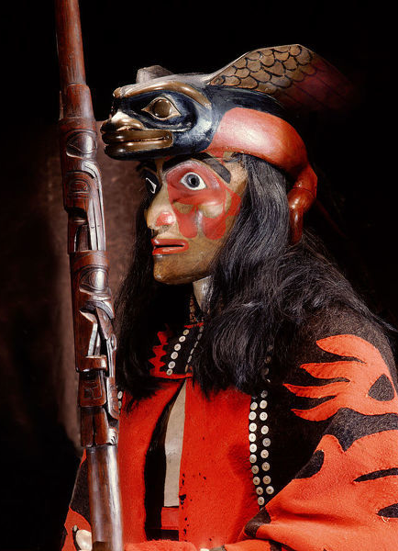
Roles and responsibilities
Each member in a community has an important role., including medicine people, leaders, elders, and skilled workers.
Elders are important because they pass on stories and information from the past. Elders also help make important decisions.

Slide 5
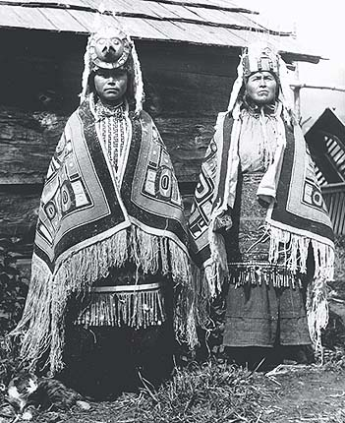
Models of government
Chiefs:
Hereditary chiefs (born into their position)
Elected chiefs (voted into their position)
Councils

Slide 6
What are some qualities of a leader?
Discussion with a partner beside you:
How do leaders make good/fair decisions?
Could you be a good leader?
What could you do to help your community?

Slide 7
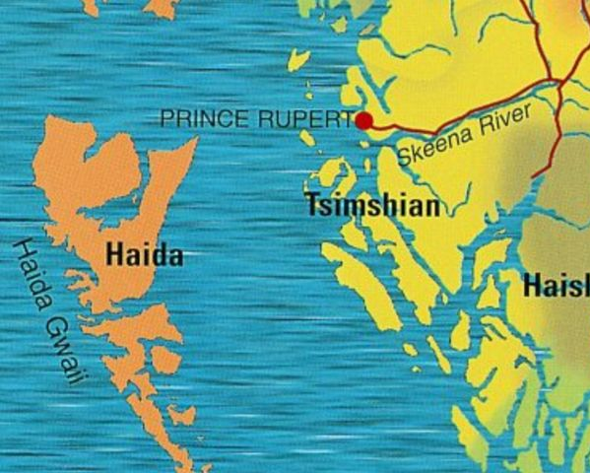
Territories and communities
Indian act
Reserves
Losing their connections to land, resources, histories, and stories made Indigenous peoples all over Canada very sad.

