Slide 1
Life-Writing: Governance and First Nations
Emily Barron
Educ. 446
Karine Veldhoen

Slide 2
The unit began with a class brainstorm, so the students could share their current knowledge prior to learning anything further.

Slide 3
Government
https://www.youtube.com/watch?v=BEb5LHhrqRQ
Follow-along with the video and fill in the blank spaces. Write a full sentence to answer the question when directed.
The main purpose of government is to keep people __________________ and to help people work ___________________.
Laws:
You must not cross the road when ________________________________.
You must not drive faster than ___________________________________.
You must not _________________________________________________.
Who helps to keep our communities safe and make sure we follow the laws?
(Answer in a full sentence)
___________________________________________________________________________________________________________________.
What are some of the services that government provides?
(Make a list, it does not need to be in full sentences)
____________________________________________________
____________________________________________________
____________________________________________________
____________________________________________________
What can the government build? (Make a list)
____________________________________________________
____________________________________________________
____________________________________________________
Where does the money come from that the government uses?
(Answer in a full sentence) ________________________________________________________.

Slide 4
Introduction to Canada’s Four Main Political Parties
Canada’s Political Parties
Name: ________________ Date: _______________
Which political party were you assigned?
________________________________________________
Who is the leader of your political party?
________________________________________________
When was your political party founded?
________________________________________________
What is the one classroom law that your party will create?
_______________________________________________
________________________________________________
________________________________________________
Liberal
NDP
Conservative
Green
The students were broken into four groups and assigned a political party to research on the iPad. In their group, they created a classroom law for our mock election to follow.

Slide 5
Mock Election Voting Card
Circle which party you would like to vote for:
Liberal Party
NDP
Green Party
Conservative Party
The students then shared their classroom law to me, and I wrote them onto the whiteboard. We conducted a mock election based on the classroom law that they liked best. The kids loved it!

Slide 6
As an extra assignment, the students could complete this crossword puzzle that I made.

Slide 7
The Pivotal Moment: Teaching First Peoples Governance for the First Time!

Slide 8
Along with the textbook displayed above, many other methods of differentiated instruction were used to accompany my teaching of this unit.
We started off with a brainstorm about what the students already knew about governance in Indigenous communities.
I was pleasantly surprised to learn that many of them had learnt about elders before and knew that elders were incredibly significant to First Peoples governance. I wrote their responses on a chart paper in BLACK ink.
Once we finished these lessons, the students told me what they had learnt about First Peoples governance, and I added their responses to the chart paper in BLUE ink, to display their growth.
The students were so proud to share what they knew and learnt about this topic. It was such a rich and rewarding experience for me as a Teacher Candidate to feel fulfilled both in my own abilities, and in the students’ passion for learning such valuable information about out local governance (and furthering their sense of place).

Slide 9
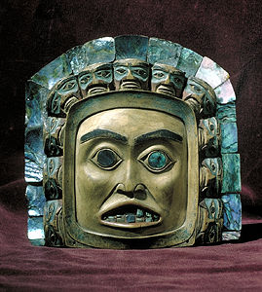
First Nations Government
Follow along on your worksheets and fill out as we go!
Remember: this topic is all about respect!

Slide 10
Multiple choice: Select one answer and circle it. True or false: write the answer on the line.
1. What can the First Nations peoples of Canada include?
Aboriginal
First Peoples
Indigenous
All of these!
2. True or false: Family is important to Indigenous communities, especially when they consider Elders?
____________________________________
3. True or false: Elders are often the teachers in Indigenous communities?
____________________________________
4. Why are elders important?
They cook lots of food
The give a lot of hugs
They pass on stories and information, and make important decisions
They wear the fanciest clothes
5. Which of the these are included in Indigenous governments?
Hereditary chiefs
Elected chiefs
Councils
All of these!
6. True or false: A leader should make decisions that only worry about themselves and not their community?
7. What happened when Canada created the Indian Act?
Indigenous peoples lost their connection to land, resources, histories, and stories
Indigenous peoples lost their connection to internet
Indigenous peoples could no longer read books
All Canadians lost their connection to land, resources, histories, and stories

Slide 11
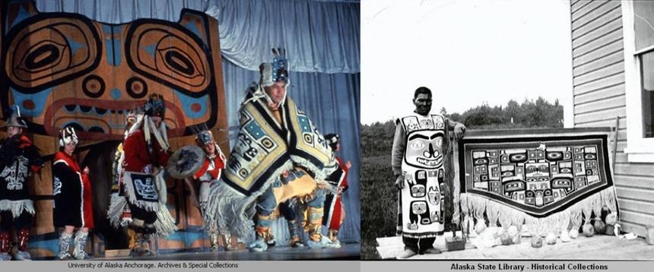
1. Who are the first nations peoples of Canada?
All of these terms include First Nations Peoples:
Aboriginal
Indigenous
First Peoples
Canada has First Nations, Inuit, and Metis peoples. Each group has their own unique languages and cultural practices. How cool!

Slide 12
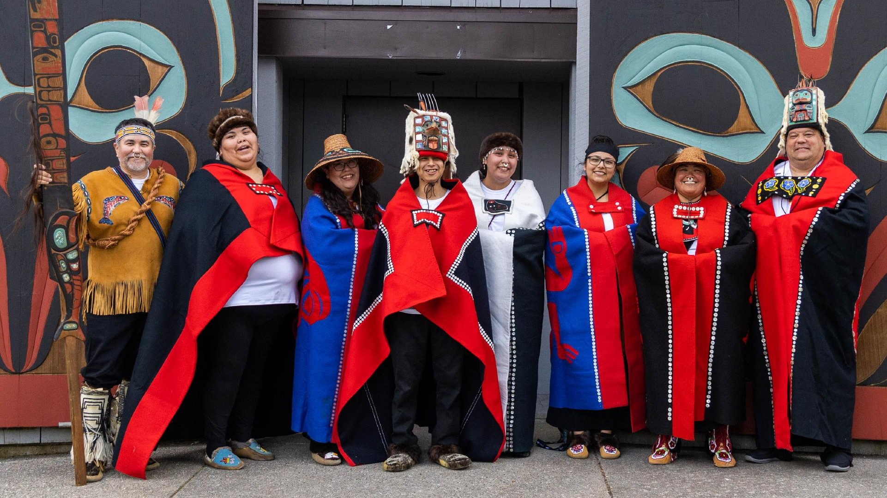
Family and community
In Indigenous communities, Elders are often the teachers.
Discussion: Is there a family member that you have who taught you a skill? What skills have they taught you?

Slide 13
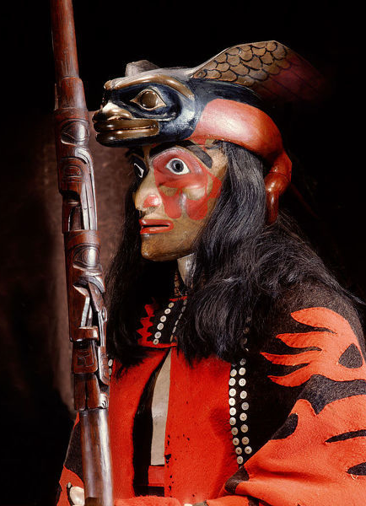
Roles and responsibilities
Each member in a community has an important role., including medicine people, leaders, elders, and skilled workers.
Elders are important because they pass on stories and information from the past. Elders also help make important decisions.

Slide 14
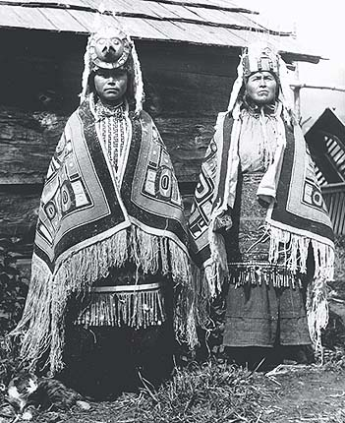
Models of government
Chiefs:
Hereditary chiefs (born into their position)
Elected chiefs (voted into their position)
Councils

Slide 15
What are some qualities of a leader?
Discussion with a partner beside you:
How do leaders make good/fair decisions?
Could you be a good leader?
What could you do to help your community?

Slide 16
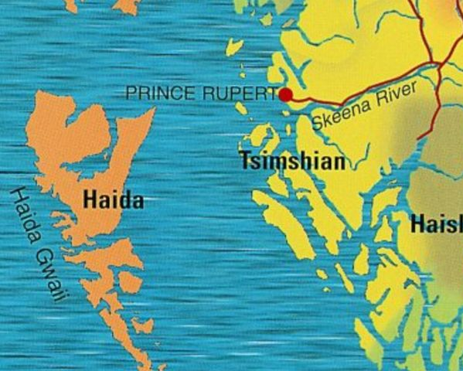
Territories and communities
Indian act
Reserves
Losing their connections to land, resources, histories, and stories made Indigenous peoples all over Canada very sad.

Slide 17
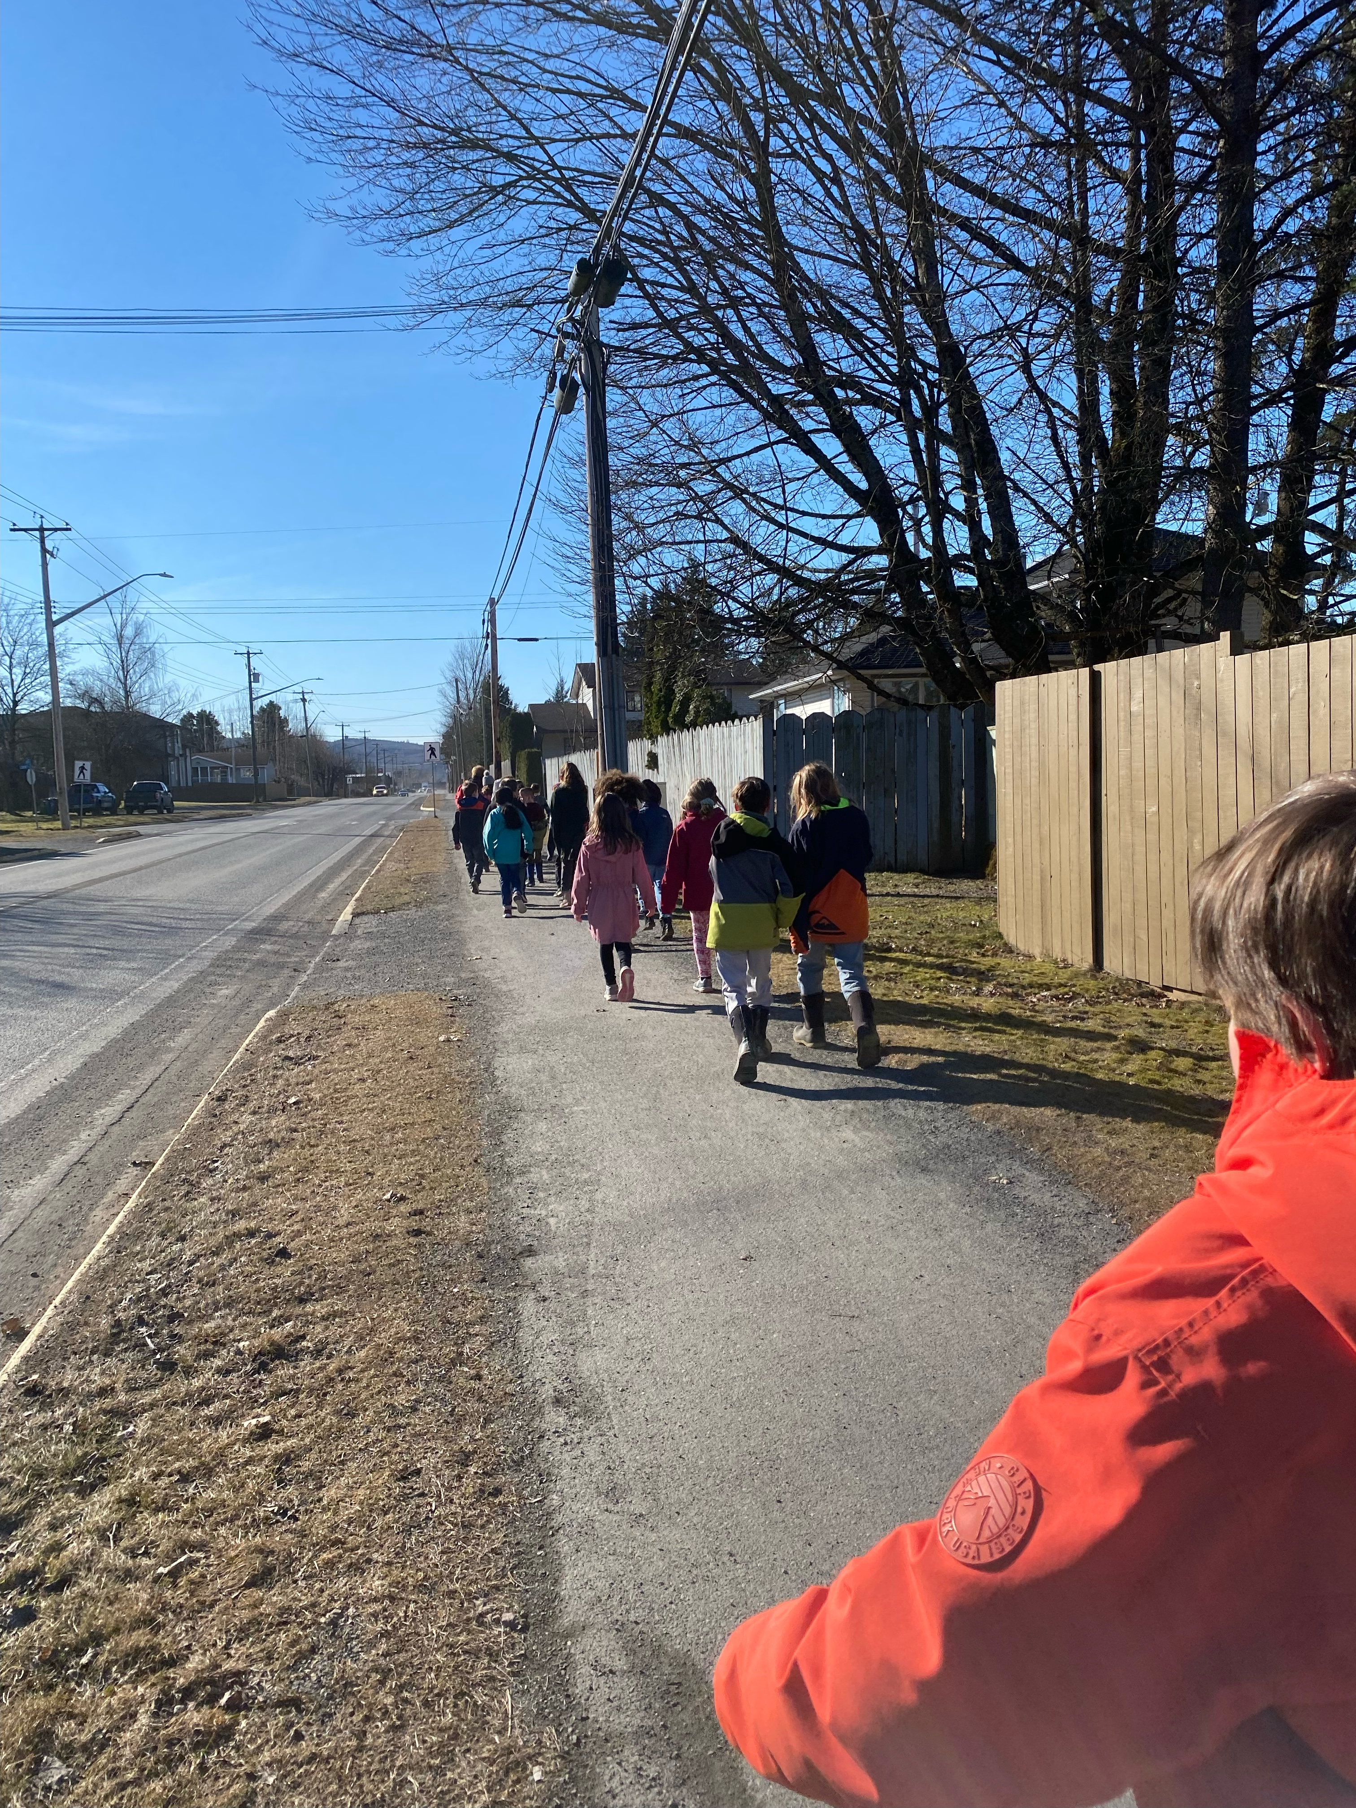
Municipal Government
We went to the local City Hall for a field trip to meet the mayor of Terrace, Carol Leclerc

Slide 18
Next, we played a game called “Attack” as a way for the students to review what they had learnt about government in a formative, and fun way.
The focus of this lesson was to allow the students to collaborate, share their knowledge, and prepare for their final assessment for this unit.

Slide 22
Conclusion
I walked away from this unit feeling nothing but pride. I think I grew so much as a future educator, as well as an advocate for implementing the First Peoples Principles of Learning into my lessons and the school environment in which I get to work and learn within.
I went through a complete rollercoaster of emotions, being unsure of my ability to teach such an important topic, seeing the progression of my students, and then believing in myself, even if it was just a little bit of a confidence boost. The students’ emotional, spiritual, and educational capabilities were amazing to witness.

