Slide 1
Emily Barron
Educ. 401
Careers:
The path of uncertainty

Slide 2
Dance is a sense of self-awareness, taking leaps and turns into the unknown of the world.
Prince George Dance Competition, 2018

Slide 3
Anybody who knows me, knows that dance was my everything growing up. It was my hobby, my daily physical activity, and my passion.
Prince George Dance Competition, Contemporary solo, 2018

Slide 4
Free Elements Dance Studio, 2017

Slide 5
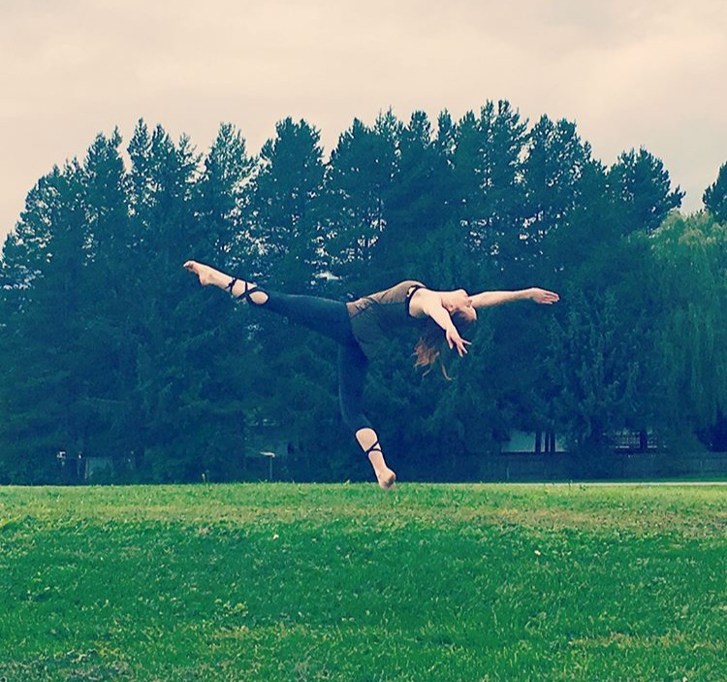
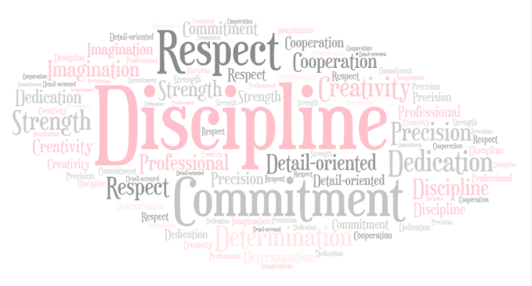
Life-Skills

Slide 6
But the biggest life skill that I gained was…

Slide 7
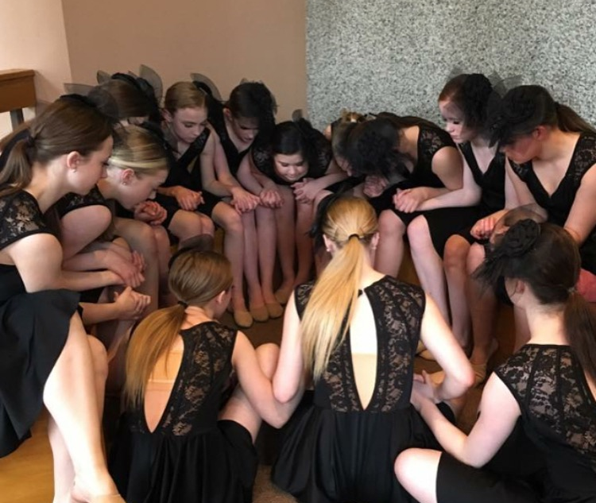
Teamwork
“Loss” – Contemporary Large Group 16 and under
BC Annual Dance Competition, Prince Rupert, 2017

Slide 8
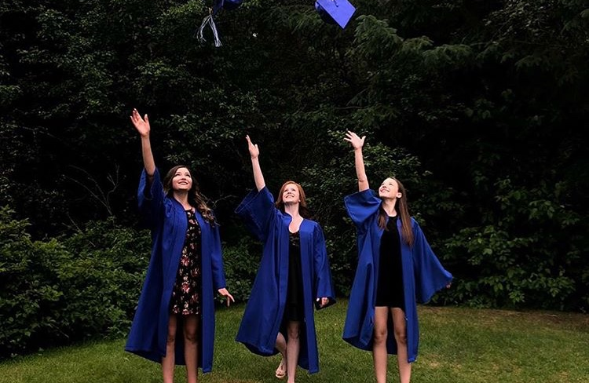
What about when it ends?
Having something that is your biggest passion and happiest place to be is a hard thing to lose. When I graduated, I felt lost without dance.

Slide 9
SO, WHAT DID I DO?

Slide 10
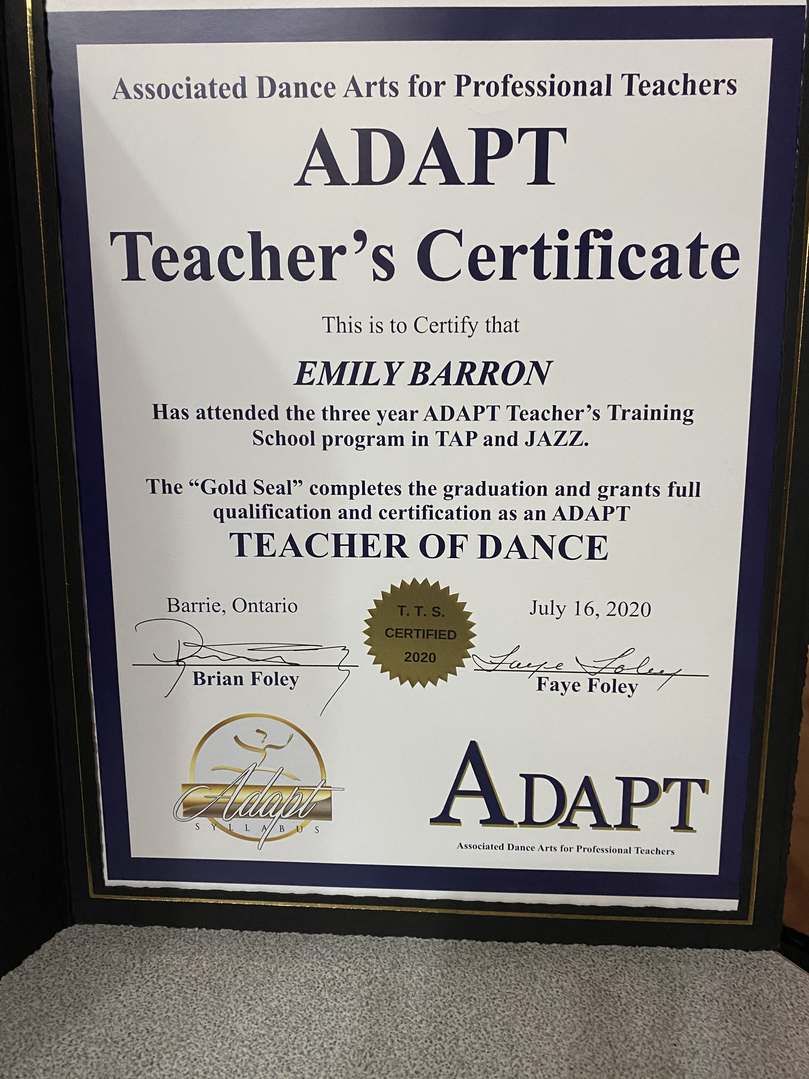
I DID BOTH!

Slide 11
Adapt Professional Teacher Training, Toronto, 2019

Slide 12
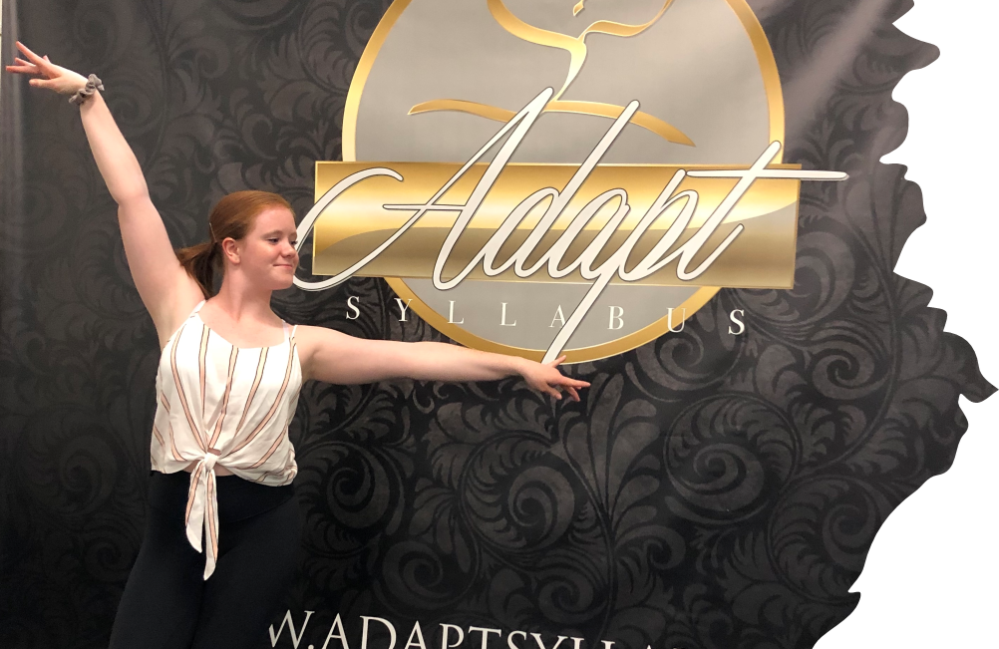
How I got there…
CHAOS THEORY
SO how did I get there? Much like chaos theory, the road was shaky and uncertain. At times, it felt unattainable and like I had no control. Time management became a tool that kept me balanced. My inspirational teachers and mentors helped me see what I was capable of. I owe my successes to them just as much as myself. There were moments when I didn’t think I could make the balance work and reconsidered both of my potential careers.
Side Note: Mr. Foley!!
Notes:
(These don’t have designer IDs since they were based off the default master slides already in the deck.

Slide 13
“Who am I?” -Contemporary Duet 15 and Under
Choreography, 2021/22
Terrace Dance Competition
*See if you can guess their storyline
https://youtu.be/qFiyzWrwNqQ?t=4514
1:15:14

Slide 14
The Unknown…
Live performances are unpredictable. This wasn’t their cleanest run of the dance and honestly, I think I lost a year off my life stressing about that prop on wheels (I swore I would never use a prop again after this).
Three weeks later, they took home an award with that same dance. This was my first piece of choreography that was recognized for placement.
Life is full of unknowns. Teaching our students about the steps that they can take to achieve their goals and aspirations through career education can take away some of the uncertainty. Sharing our personal experiences with Chaos Theory and the unknown will assist them with guiding their own career pathways.

Slide 15
Dance is a sense of self-awareness, taking leaps and turns into the unknown of the world.

Slide 16
Sharing My Passion

Slide 17
Thank you

